Slide 1
3rd
Present Simple - 3rd person singular
Present
Simple
person
singular

Slide 2
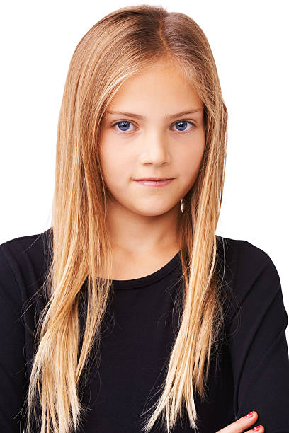
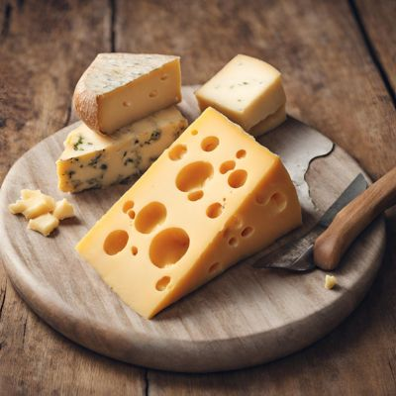
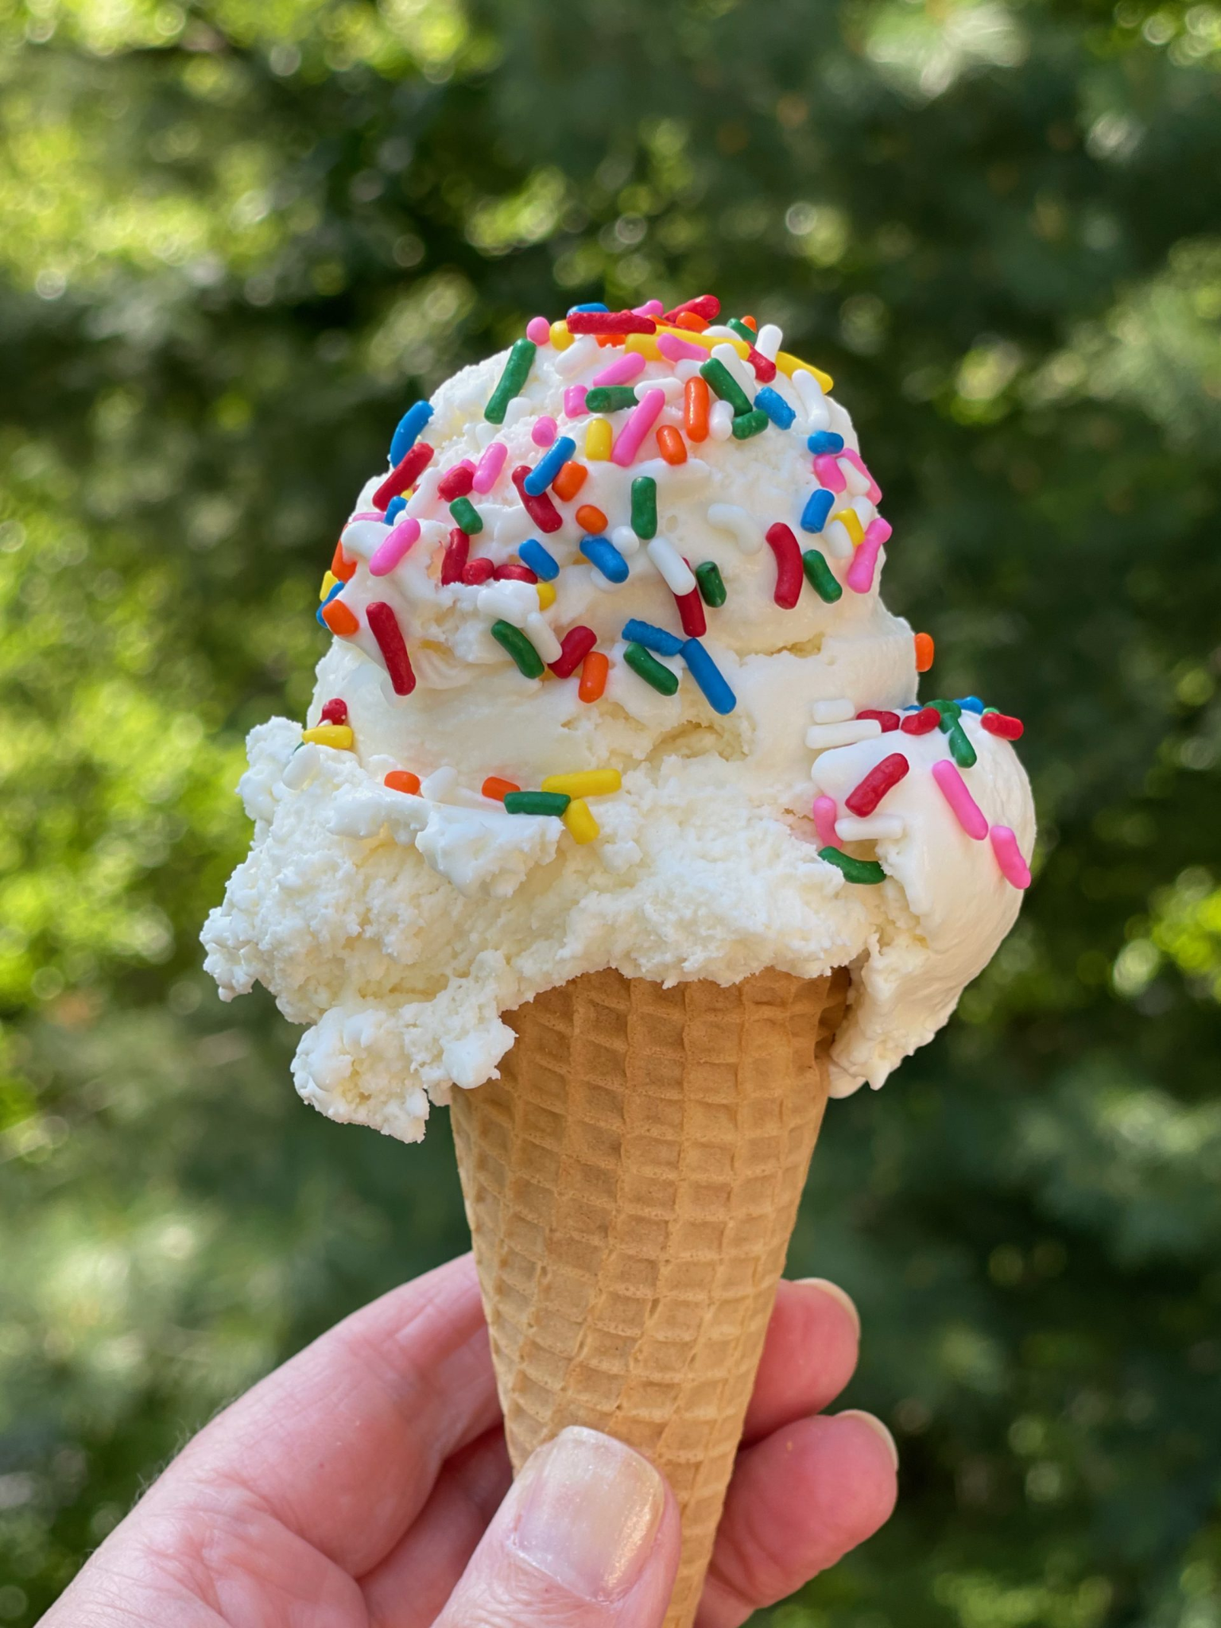
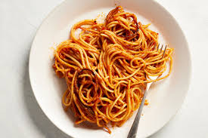
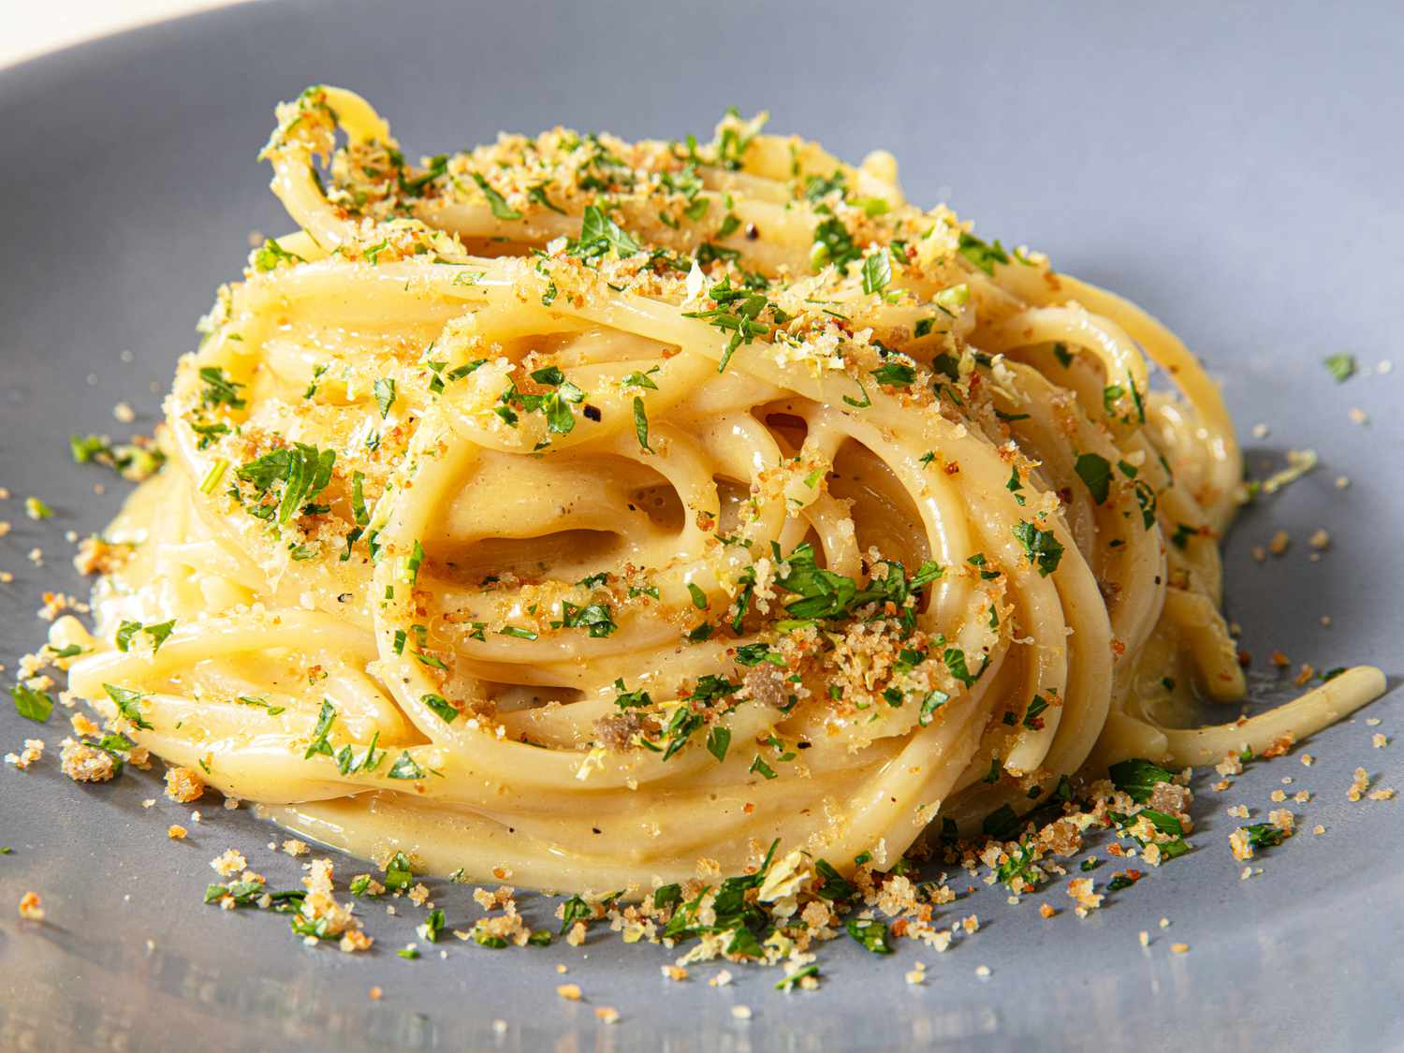
Messenger
Level passed!
🔓
🔒
🔒
🔓
Hi! I am Nika 😉 I’m 11 years old
I love spaghetti and ice cream 😍
Уведомление
ℹ
I like cheese too) 🧀🧀🧀🧀
Анимации завершены.
Ok
I have a lot of spaghetti with cheese on my plate
🔒
🔓
Открыть профиль
Открыть фотографии
Открыть фотографии
Заблокировать
Заблокировать
Nika
Nika is typing…
Нажмите клавишу или кнопку мыши для продолжения анимации

Slide 3
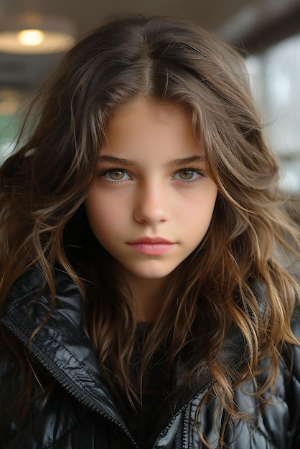
Mail
Arial
T
B
I
U
1
T
2
3
Hi, Mia! I am Nika 😉 I’m 11 years old. I love spaghetti and ice cream 😍. I like cheese too) I have a lot of spaghetti with cheese on my plate.
I have a sister, Evelina. She (be) ___ 9 years old. She (have) ____ a lot of peanuts in her room)) She (love) ____ avocado and peanuts. Evelina also (like) _____ cheese, like me 😀 .
Уведомление
is
ℹ
Анимации завершены.
has
loves
likes
Ok
Loading…
= She
He / she / it + глаголs
Ok
Mia
Нажмите клавишу или кнопку мыши для продолжения анимации

Slide 4
Thanks for watching!
Sponsored by Google

